Slide 1
Linear Regression
CMPUT 328
Nilanjan Ray
Computing Science, University of Alberta, Canada
Material source: “Hands-on machine learning with Scikit-Learn and TensorFlow: concepts, tools, and techniques to build intelligent systems,” by Géron, Aurélien.

Slide 2
Linear regression with PyTorch
We will start with a linear regression “model”
Next, we need to understand “loss” function for regression task
Next we will estimate the model by minimizing the loss function
We will use PyTorch

Slide 3
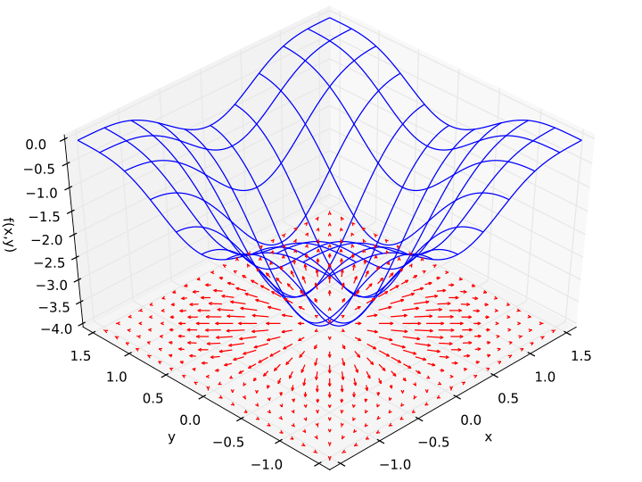

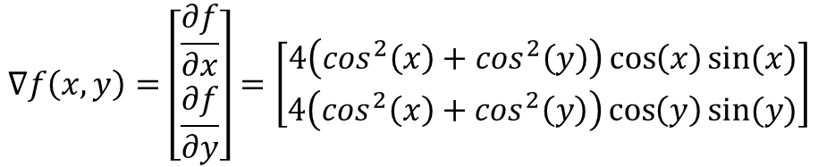
Quick review: Gradient of a function
Example:
$$f\left(x,y\right)=−{\left(\cos^{2}x+\cos^{2}y\right)}^{2}$$
$$∇f\left(x,y\right)=\left[\begin{matrix}\frac{∂f}{∂x} \\ \frac{∂f}{∂y}\end{matrix}\right]=\left[\begin{matrix}4\left(\cos^{2}\left(x\right)+\cos^{2}\left(y\right)\right)\cos\left(x\right)sin⁡(x) \\ 4\left(\cos^{2}\left(x\right)+\cos^{2}\left(y\right)\right)\cos\left(y\right)sin⁡(y)\end{matrix}\right]$$
Note 1: f is a function of two variables,
so gradient of f is a two dimensional vector
Note 2: Gradient (vector) of f points toward the
steepest ascent for f
Note 3: At a (local) minimum of f its gradient
becomes a zero vector
Example source: Wikipedia

Slide 4
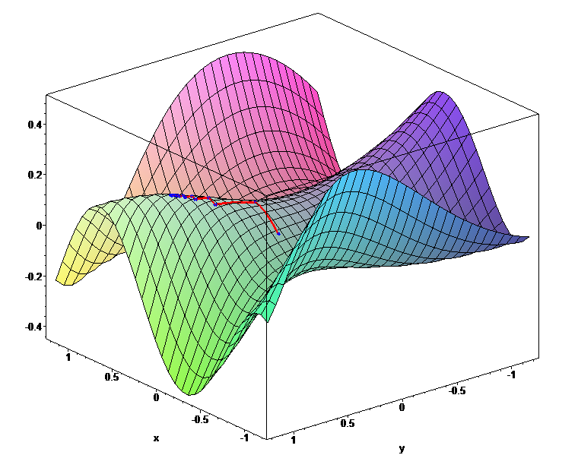
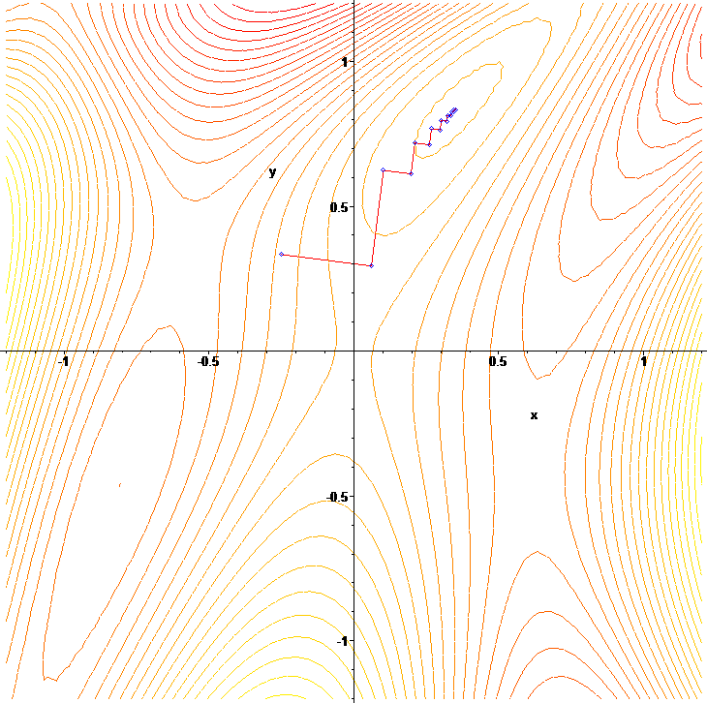



Quick review: Gradient descent optimization
Start at an initial guess for the optimization variable:
$$x_{0}$$
Gradient descent algorithm
Iterate until gradient magnitude becomes too small:
$$x^{t+1}=x^{t}−α∇f(x^{t})$$
$$α$$
is called the step-length.
f(x, y)
Gradient descent creates
a zig-zag path leading to
a local minimum of f
Picture source: Wikipedia

Slide 5
Supervised machine learning: the tabular view
Prediction / dependent variable
Independent variable (aka feature vector)
x
y
Map (Sup. ML)
x₁ | x₂ | x₃ | x₄ | y
1.2 | -3.9 | 4.0 | 0 | 1.6
2.1 | 2.4 | -0.7 | -0.2 | 1.2
… | … | … | … | …
… | … | … | … | …
3.2 | … | … | 1.9 | 0.3
1.4 | … | … | 1.5 | ?
3.1 | … | … | 2.1 | ?
ML learns to map x to y
In other words, ML learns
a function, f so that
y = f(x)
Training data: complete table
The function f is called prediction function
Test data: incomplete table

Slide 6






Linear prediction: formal setup
Linear prediction function:
or,
$$y^{p}=\sum_{j=1}^{m}{θ_{j}x_{j}}+b$$
$$y^{p}=xθ+b$$
vector equation form
scalar equation form
A training set consists of (x, y) pairs:
$${\left\{\left(x_{i},y_{i}\right)\right\}}_{i=1}^{n}$$
Linear prediction on the training data point i:
$$y_{i}^{p}=x_{i}θ+b$$
or,
$$y_{i}^{p}=\sum_{j=1}^{m}{θ_{j}x_{i,j}}+b$$
Loss or cost function (on training data):
$$L=\frac{1}{2}\sum_{i=1}^{n}{{(y_{i}^{p}−y_{i})}^{2}}$$
Learning the linear model: find out θ and b to minimize loss function

Slide 7



Learning a linear model
For the convenience of math, let us change our linear model a bit:
$$y_{i}^{p}=\sum_{j=1}^{m}{θ_{j}{(x}_{i,j}−{\overline{x}}_{j})}+b$$
$${\overline{x}}_{j}=\frac{1}{n}\sum_{i=1}^{n}{x_{i,j}}$$
where,
And a slightly modified loss function:
$$L=\frac{1}{2}\sum_{i=1}^{n}{{(y_{i}^{p}−y_{i})}^{2}}+\frac{γ}{2}\sum_{j=1}^{m}{θ_{j}^{2}}$$
γ is a hyper parameter
Data fidelity
Regularization
Why do we need regularization?

Slide 8






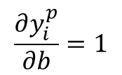
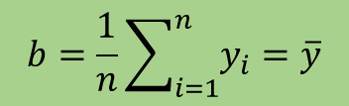
Minimization of linear regression loss function
Regularized loss function:
$$L=\frac{1}{2}\sum_{i=1}^{n}{{(y_{i}^{p}−y_{i})}^{2}}+\frac{γ}{2}\sum_{j=1}^{m}{θ_{j}^{2}}$$
$$\frac{∂L}{∂b}=\sum_{i=1}^{n}{(y_{i}^{p}−y_{i})\frac{∂y_{i}^{p}}{∂b}}=\sum_{i=1}^{n}{(y_{i}^{p}−y_{i}) }$$
$$\frac{∂y_{i}^{p}}{∂b}=1$$
Taking partial derivative using chain rule:
because,
Using
$${\overline{x}}_{j}=\frac{1}{n}\sum_{i=1}^{n}{x_{i,j}}$$
and
$$y_{i}^{p}=\sum_{j=1}^{m}{θ_{j}{(x}_{i,j}−{\overline{x}}_{j})}+b$$
we get:
$$\frac{∂L}{∂b}=nb−\sum_{i=1}^{n}{y_{i}}$$
$$\frac{∂L}{∂b}=0$$
$$b=\frac{1}{n}\sum_{i=1}^{n}{y_{i}}=\overline{y}$$
At the minimum of L,
So,

Slide 9
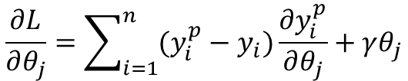
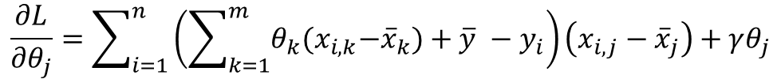

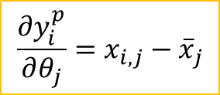


Minimization of linear regression loss function…
Regularized loss function:
Taking partial derivative of L using chain rule:
$$L=\frac{1}{2}\sum_{i=1}^{n}{{(y_{i}^{p}−y_{i})}^{2}}+\frac{γ}{2}\sum_{j=1}^{m}{θ_{j}^{2}}$$
$$\frac{∂L}{∂θ_{j}}=\sum_{i=1}^{n}{(y_{i}^{p}−y_{i})\frac{∂y_{i}^{p}}{∂θ_{j}}}+γθ_{j}$$
$$y_{i}^{p}=\sum_{k=1}^{m}{θ_{k}{(x}_{i,k}−{\overline{x}}_{k})}+b,$$
$$\frac{∂y_{i}^{p}}{∂θ_{j}}=x_{i,j}−{\overline{x}}_{j}$$
Using
$$b=\overline{y}$$
and
$$\frac{∂L}{∂θ_{j}}=\sum_{i=1}^{n}{\left(\sum_{k=1}^{m}{θ_{k}{(x}_{i,k}−{\overline{x}}_{k})}+\overline{y} −y_{i}\right)\left(x_{i,j}−{\overline{x}}_{j}\right)}+γθ_{j}$$
We get:

Slide 10




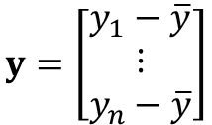

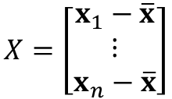

Minimization of linear regression loss function…
$$\frac{∂L}{∂θ_{j}}=\sum_{i=1}^{n}{\left(\sum_{k=1}^{m}{θ_{k}{(x}_{i,k}−{\overline{x}}_{k})}+\overline{y} −y_{i}\right)\left(x_{i,j}−{\overline{x}}_{j}\right)}+γθ_{j}$$
simplification
Gradient of L:
$$∇L=\left[\sum_{i=1}^{n}{{(x_{i}−\overline{x})}^{T}(x_{i}−\overline{x}) } \right]θ+γθ−\sum_{i=1}^{n}{(y_{i}−\overline{y}){(x_{i}−\overline{x})}^{T}}$$
where
$$x_{i}=\left[\begin{matrix}x_{i,1} & … & x_{i,m}\end{matrix}\right],$$
$$\overline{x}=\left[\begin{matrix}{\overline{x}}_{1} & ⋯ & {\overline{x}}_{m}\end{matrix}\right]$$
and
$$θ={\left[\begin{matrix}θ_{1} & ⋯ & θ_{m}\end{matrix}\right]}^{T}$$
More simplified form:
$$∇L=\left(X^{T}X+γI\right)θ−X^{T}y$$
$$X=\left[\begin{matrix}x_{1}−\overline{x} \\ ⋮ \\ x_{n}−\overline{x}\end{matrix}\right]$$
$$y=\left[\begin{matrix}y_{1}−\overline{y} \\ ⋮ \\ y_{n}−\overline{y}\end{matrix}\right]$$
where matrix X is defined as:
and vector y is defined as:
and I is an identity matrix of size m-by-m
Equating gradient of L to zero vector and solving gives us:
$$θ={(X^{T}X+γI)}^{−1} X^{T}y$$

Slide 11



Linear regression by gradient descent
$$θ={(X^{T}X+γI)}^{−1} X^{T}y$$
If the data does not fit into the memory, you cannot compute θ directly with the above formula;
you apply gradient descent to compute it (approximately).
$$∇L\left(θ;X,y\right)=X^{T}Xθ+γθ−X^{T}y$$
Guess a starting value for θ = θ₀
Initialize learning rate and regularization parameter: α, γ
Iterate for t = 0, 1,…
Gradient descent algorithm
Consider a subset of data (X_{t}, y_{t})
Update:
$$θ_{t+1}=θ_{t}−α∇L(θ_{t};X_{t},y_{t})$$
Also known as batch update or batch method

Slide 12
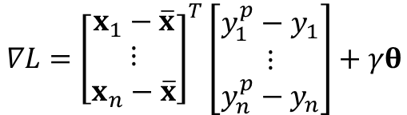






Derivation using vector calculus
Regularized loss function:
$$L=\frac{1}{2}\sum_{i=1}^{n}{{(y_{i}^{p}−y_{i})}^{2}}+\frac{γ}{2}\sum_{j=1}^{m}{θ_{j}^{2}}$$
or,
$$L=\frac{1}{2}\sum_{i=1}^{n}{{(y_{i}^{p}−y_{i})}^{2}}+\frac{γ}{2}θ^{T}θ$$
Using vector calculus:
$$∇L=\sum_{i=1}^{n}{(y_{i}^{p}−y_{i})∇y_{i}^{p}}+\frac{γ}{2}∇(θ^{T}θ)$$
Use vector differentiation to:
$$y_{i}^{p}=(x_{i}−\overline{x})θ+\overline{y}$$
and get:
$$∇y_{i}^{p}={(x_{i}−\overline{x})}^{T}$$
Also note, using vector differentiation rule:
$$∇\left(θ^{T}θ\right)=2θ$$
$$∇L={\left[\begin{matrix}x_{1}−\overline{x} \\ ⋮ \\ x_{n}−\overline{x}\end{matrix}\right]}^{T}\left[\begin{matrix}y_{1}^{p}−y_{1} \\ ⋮ \\ y_{n}^{p}−y_{n}\end{matrix}\right]+γθ$$
“centered data”
“error”
https://en.wikipedia.org/wiki/Matrix_calculus

Slide 13
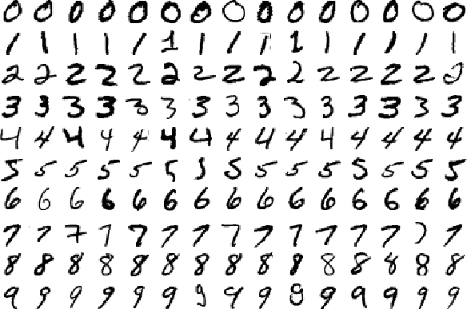
MNIST Dataset
Classify images into digits
Each image is 28x28
10 labels
55,000 training images
5,000 validation images
10,000 test images.

Slide 14

Linear regression on MNIST dataset
Pixel values (feature)
Digit
Small 28 pixels-by-28 pixels images of hand written digits
The visual recognition problem definition:
to recognize the digit from an image
x₁ | x₂ | … | x₇₈₄ | y
0.1 | 0.3 | … | 0.0 | 0
0.2 | 0.1 | … | 0.5 | 1
… | … | … | … | …
… | … | … | … | …
0.0 | 0.98 | … | 0.8 | 9
0.5 | 0.25 | … | 0.36 | ?
0.1 | 0.95 | … | 0.1 | ?
Our very first line of attack would be to use linear regression.
Feature dimension, m = 28 * 28 = 784
Let’s look at our PyTorch implementation

